Slide 1
Part 4: Network Layer
Part A: Algorithms
Notes:
Page <number>

Slide 2
1. The Problem (1)
Store-and-Forward Packet Switching
Services Provided to the Transport Layer
    Connectionless Service
    Connection-Oriented Service
Notes:
Page <number>
Research on DTN, Localization

Slide 3

1. The Problem (2): Packet Switching
fig 5-1
The environment of the network layer protocols.
Notes:
Page <number>
Research on DTN, Localization

Slide 4

1. The Problem (3): Connectionless Service
Routing within a diagram subnet.
Notes:
Page <number>
Research on DTN, Localization

Slide 5

1. The Problem (4): Connection-Oriented Service
Routing within a virtual-circuit subnet.
Notes:
Page <number>
Research on DTN, Localization

Slide 6

1. The Problem (5): Connectionless VS. Connection-Oriented
Notes:
Page <number>
Research on DTN, Localization

Slide 7
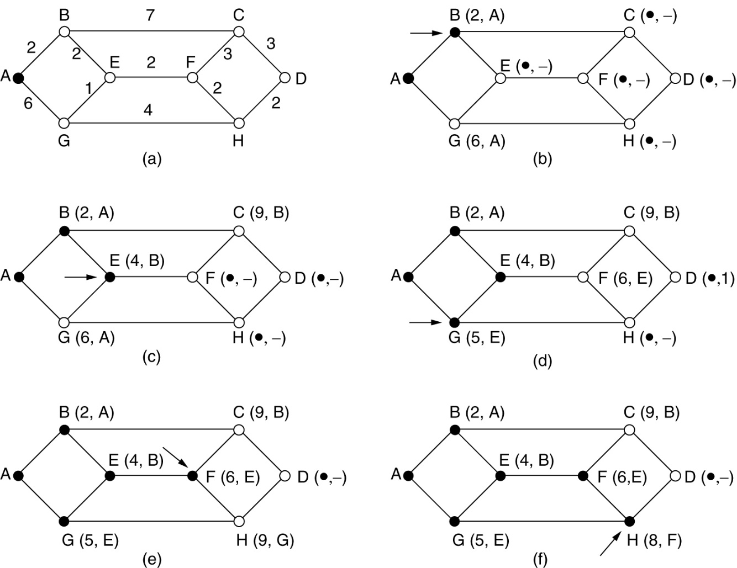
2 Shortest Path Algorithm
The first 5 steps used in computing the shortest path from A to D.
The arrows indicate the working node.

Slide 8
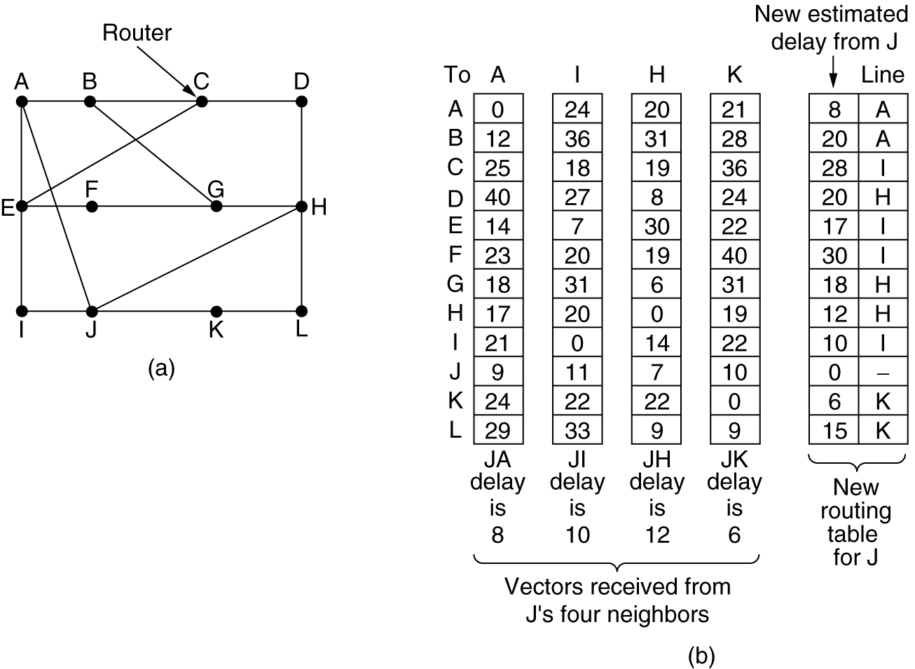
3 Distance Vector Routing (1)
(a) A subnet. (b) Input from A, I, H, K, and the new
routing table for J.

Slide 9
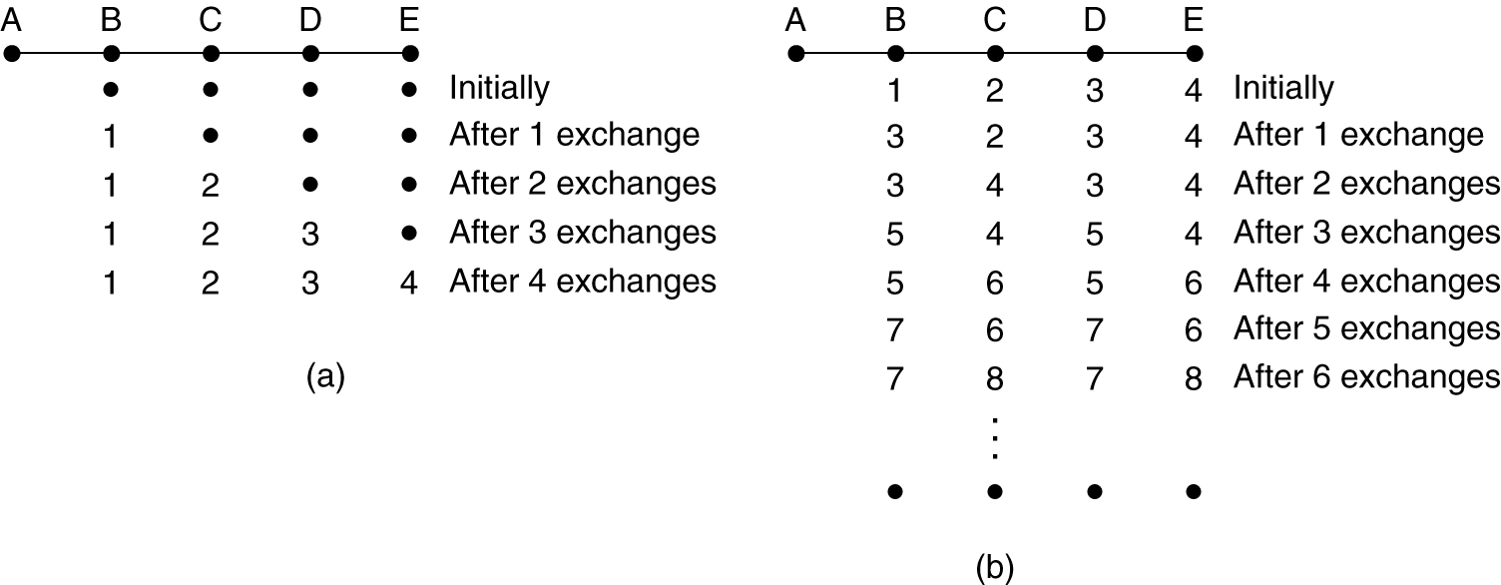
3 Distance Vector Routing (2)
The count-to-infinity problem.

Slide 10
3 Distance Vector Routing (3): Loop-Breaking Heuristics
Set infinity to a limited number, e.g. 16.
Split horizon
Split horizon with poison reverse

Slide 11
3 Example:
A
B
C
A
0
D
0
B
C
A
D
E
1
A
D
2
B
E
C
10
2
E
D
E
0
2
B
C
A
A
B
0
B
C
Initialization
C
0
D
D
E
E

Slide 12
A
1
A
0
B
B
10
C
2
C
D
0
D
1
D
E
2
A
A
E
1
2
B
C
2
10
2
E
D
2
E
0
2
B
C
A
10
A
B
0
B
C
Direct
Neighbours
C
0
D
2
D
E
2
E

Slide 13
A
1
A
0
B
11
B
10
C
2
C
3
D
0
D
1
D
E
2
A
A
3
E
3
1
2
B
C
2
10
2
E
D
2
E
0
2
B
C
A
10
3
A
B
0
Neighbours
of neighbours
B
C
C
0
D
11
2
D
E
2
E

Slide 14
A
1
A
0
B
11
B
10
C
2
C
3
D
0
D
1
D
E
2
A
A
3
E
3
1
2
B
13
C
2
10
2
E
D
2
E
0
2
B
C
A
10
3
A
Neighbours
of neighbours
of neighbours
B
0
B
13
C
13
C
0
D
11
2
D
E
13
E
2

Slide 15
A
1
A
0
B
11
B
10
C
2
C
3
D
0
D
1
D
E
2
A
A
3
E
3
1
2
B
13
C
2
10
2
E
D
2
E
0
2
B
C
A
10
3
A
B
0
Stable
convergence
B
13
C
13
C
0
D
11
2
D
E
13
E
2

Slide 16
A
1
A
0
B
11
B
10
C
2
C
3
D
0
D
1
D
E
2
A
A
3
E
3
1
2
B
13
C
2
10
2
E
D
2
E
0
2
B
1
C
A
10
3
A
Good news:
A new link!
B
0
B
13
C
13
C
0
D
11
2
D
E
13
E
2

Slide 17
A
1
A
0
B
11
B
10
C
2
C
3
D
0
D
1
D
E
2
A
A
3
E
3
1
2
B
13
C
2
10
2
E
D
2
E
0
2
B
1
C
A
10
3
A
B
0
Direct
endpoints
know
B
1
C
1
C
0
D
11
2
D
E
13
E
2

Slide 18
A
1
A
0
B
3
B
10
C
2
C
3
D
0
D
1
D
E
2
A
A
3
E
3
1
2
B
3
C
2
10
2
E
D
2
E
0
2
B
1
C
A
4
3
A
B
0
Neighbours
know
B
1
C
1
C
0
D
3
2
D
E
3
E
2

Slide 19
A
1
A
0
B
3
B
4
C
2
C
3
D
0
D
1
D
E
2
A
A
3
E
3
1
2
B
3
C
2
10
2
E
D
2
E
0
2
B
1
C
A
4
3
A
Neighbours
of neighbours
know
B
0
B
1
C
1
C
0
D
3
2
D
E
3
E
2

Slide 20
A
1
A
0
B
3
B
4
C
2
C
3
D
0
D
1
D
E
2
A
A
3
E
3
1
2
B
3
C
2
10
2
E
D
2
E
0
2
B
1
C
A
4
3
A
B
0
A happy and
stable network
B
1
C
1
C
0
D
3
2
D
E
3
E
2

Slide 21
A
1
A
0
B
3
B
4
C
2
C
3
D
0
D
1
D
E
2
A
A
3
E
3
1
2
B
3
C
2
10
2
E
D
2
E
0
2
B
C
A
4
3
A
Bad news:
Link crash!!
B
0
B
1
C
1
C
0
D
3
2
D
E
3
E
2

Slide 22
A
1
A
0
B
3
B
4
C
2
C
3
D
0
D
1
D
E
2
A
A
3
E
3
1
2
B
3
C
2
10
2
E
D
2
E
0
2
B
C
A
3
A
Direct
endpoints
know
B
0
B
C
C
0
D
2
D
E
2
E

Slide 23
A
1
A
0
B
3
B
4
C
2
C
3
D
0
D
1
D
E
2
A
A
3
E
3
1
2
B
3
C
2
10
2
E
D
2
E
0
2
10
B
C
A
3
A
B
0
B
C
C
0
D
2
D
E
2
E

Slide 24
A
1
A
0
B
3
B
4
C
2
C
3
D
0
D
1
D
E
2
A
A
3
E
3
1
2
B
3
C
2
10
2
E
D
2
E
0
2
10
B
C
A
3
A
Get help
from
neighbours
B
0
B
5
C
13
C
0
D
11
D
2
E
13
2
E

Slide 25
A
1
A
0
B
7
B
4
C
2
C
3
D
0
D
1
D
E
2
A
A
3
E
3
1
2
B
7
C
2
10
2
E
D
2
E
0
2
10
B
C
A
3
A
Routing loop
(due to
inconsistent
state info)
B
0
B
5
C
13
C
0
D
11
D
2
E
13
2
E

Slide 26
A
1
A
0
B
7
B
8
C
2
C
3
D
0
D
1
D
E
2
A
A
3
E
3
1
2
B
7
C
2
10
2
E
D
2
E
0
2
10
B
C
A
3
A
B
0
B
9
C
13
C
0
D
11
D
2
E
13
2
E

Slide 27
A
1
A
0
B
11
B
8
C
2
C
3
D
0
D
1
D
E
2
A
A
3
E
3
1
2
B
11
C
2
10
2
E
D
2
E
0
2
10
B
C
A
3
A
B
0
Counting
to infinity…
B
9
C
13
C
0
D
11
D
2
E
13
2
E

Slide 28
A
1
A
0
B
11
B
10
C
2
C
3
D
0
D
1
D
E
2
A
A
3
E
3
1
2
B
11
C
2
10
2
E
D
2
E
0
2
10
B
C
A
3
A
B
0
B
13
C
13
C
0
D
11
D
2
E
13
2
E

Slide 29
A
1
A
0
B
11
B
10
C
2
C
3
D
0
D
1
D
E
2
A
A
3
E
3
1
2
B
13
C
2
10
2
E
D
2
E
0
2
10
B
C
A
3
A
B
0
B
13
C
13
C
0
D
11
D
2
E
13
2
E

Slide 30
A
1
A
0
B
11
B
10
C
2
C
3
D
0
D
1
D
E
2
A
A
3
E
3
1
2
B
13
C
2
10
2
E
D
2
E
0
2
10
B
C
A
3
A
B
0
Stability
again
B
13
C
13
C
0
D
11
D
2
E
13
2
E

Slide 31
4 Link State Routing (1)
Each router must do the following:
Discover its neighbors, learn their network address.
Measure the delay or cost to each of its neighbors.
Construct a packet telling all it has just learned.
Send this packet to all other routers.
Compute the shortest path to every other router.

Slide 32
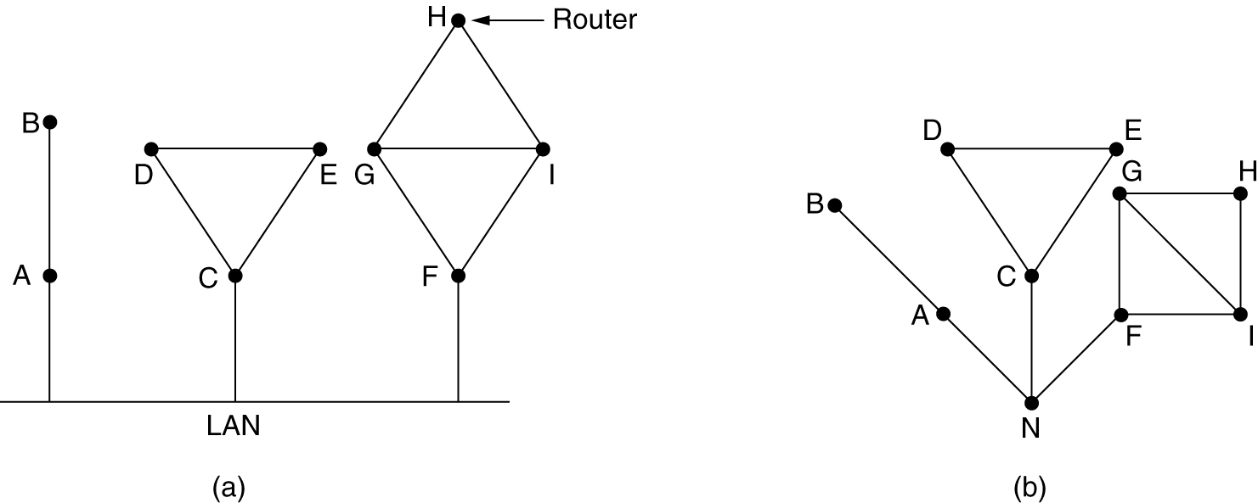
4 Link State Routing (2): Learning about the Neighbors
Nine routers and a LAN.
A graph model of (a).

Slide 33
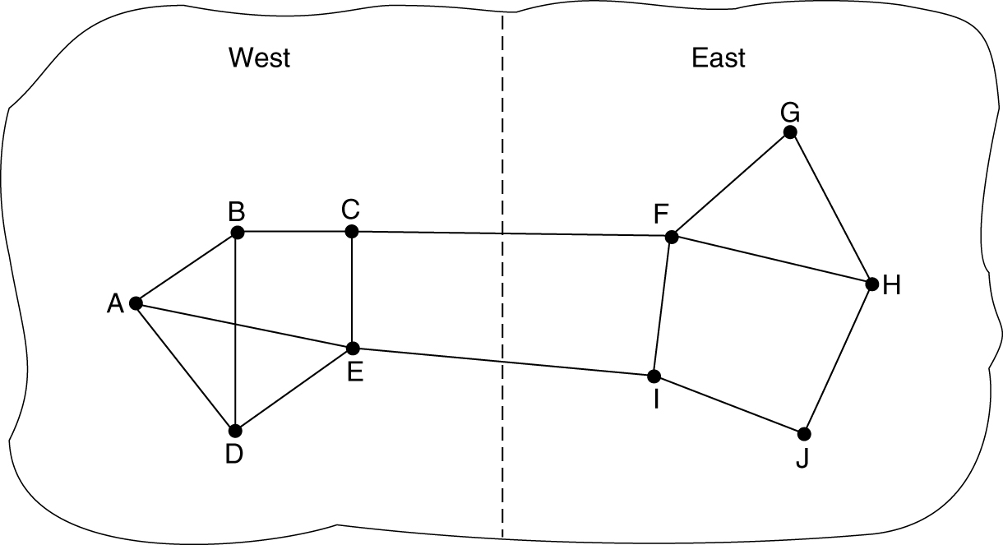
4 Link State Routing (3): Measuring Line Cost
A subnet in which the East and West parts are connected by two lines.

Slide 34
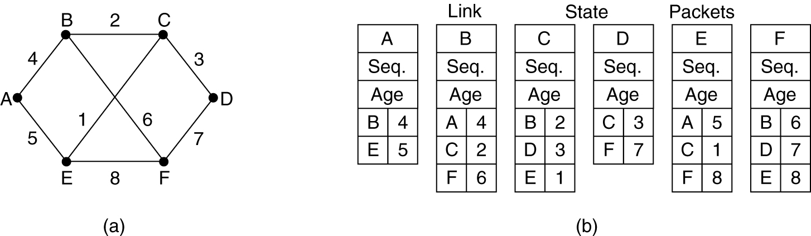
4 Link State Routing (4): Building Link State Packets
(a) A subnet. (b) The link state packets for this subnet.

